Slide 1
A brief history of five points
El paso county historical society

Slide 2
Five points in 1917
Name: “The name ‘Five Points’ was favored because the location of the places of business are at a point where Montana Street, Elm Street, Piedras Street, and East Boulevard all meet.”—(El Paso Morning Times, 9/16/1917, reprinted in “Tales from the Morgue,” El Paso Times)
“Second Chamber of Commerce”
“The avowed purpose of which is to make known to all the central portion of the city that there is…a group of up-to-date business undertakings which warrant trading there, thus elimination time and carfare spent in making downtown purchases.”
A business center.

Slide 3
A business district

Slide 4
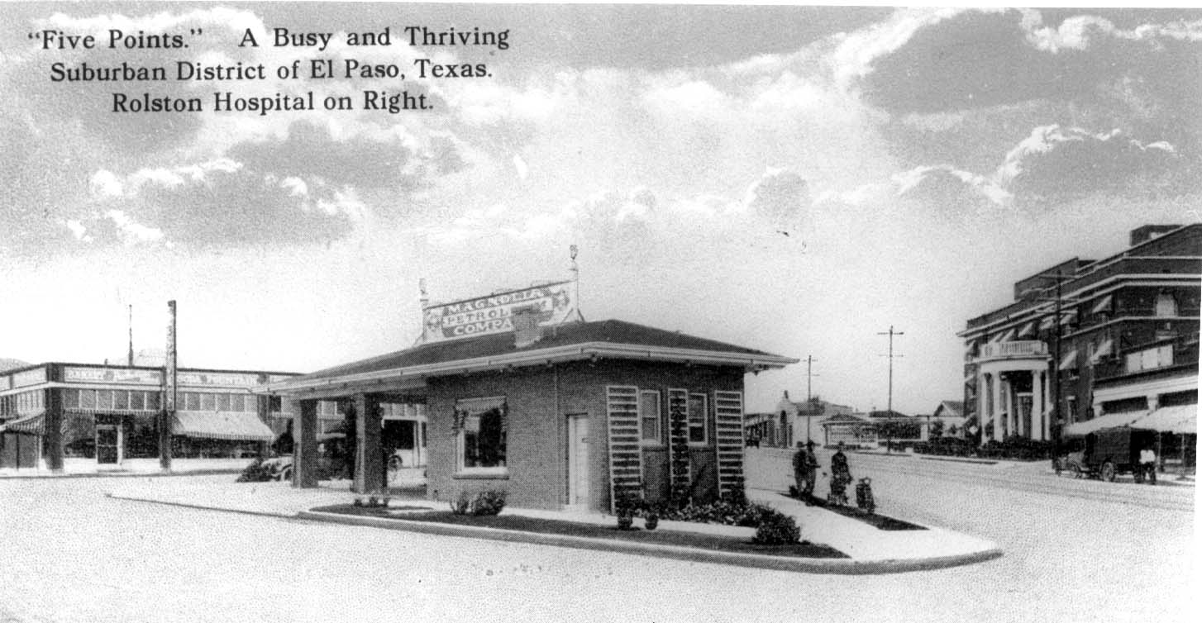
Circa 1920

Slide 5
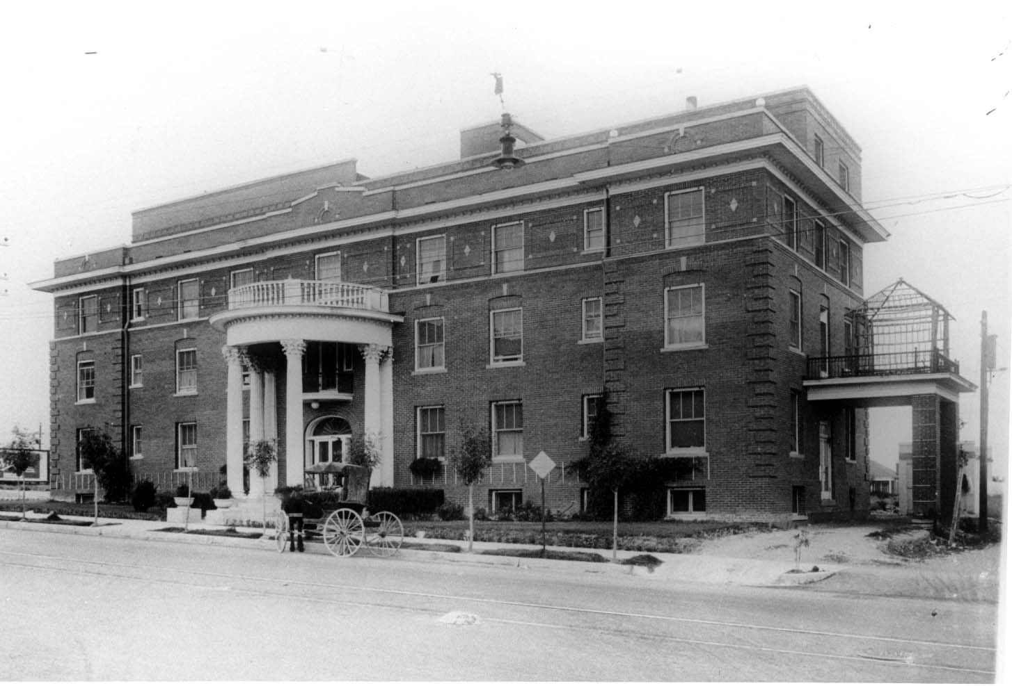
Rolston hospital (Later masonic hospital), circa 1920

Slide 6
1920s-1930s (1st person recollections of j. harry miskimins, M.d.
“A busy shopping center…And a wonderful place.”
Lived at 2925 Montana
“Bustling with people coming and going to the stores…”
1919, his father bought drugstore at 910 N. Piedras (Next door to Rolston Hospital).
Rolston—60-65 Beds
Properties sold in 1953 to Sears ($20,000).
A lot near his home, underdeveloped, used for sandlot baseball.

Slide 7
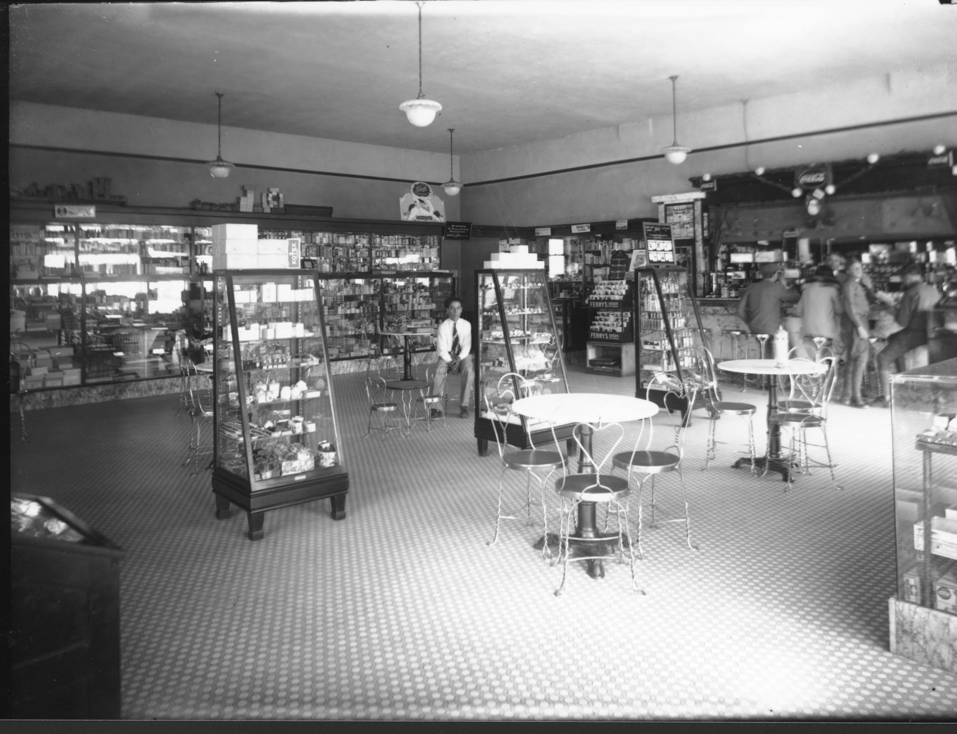
Interior rolston drug store

Slide 8
Miskimins’s recollections
Attended Fannin (Corner of San Jose and Alabama). “At the time there wasn’t any Alabama right there, merely a sand pit used by construction companies.”
Mentions “Austin High School.”—Really Houston Elementary
Crockett School and then Houston School (as a 7th grade student).
“Favorite pastimes…was ‘kick the can,’ and our favorite place to play it was on the steps of the Church of Christ…the northeast corner of Montana and Raynor.”
“Many were the times…we kicked the can into the sides of moving cars.”
Other pharmacies—Gunning Castile (across from Rolston Hospital/Rolston Drugstore and Ideal Pharmacy, further south on Piedras).

Slide 9
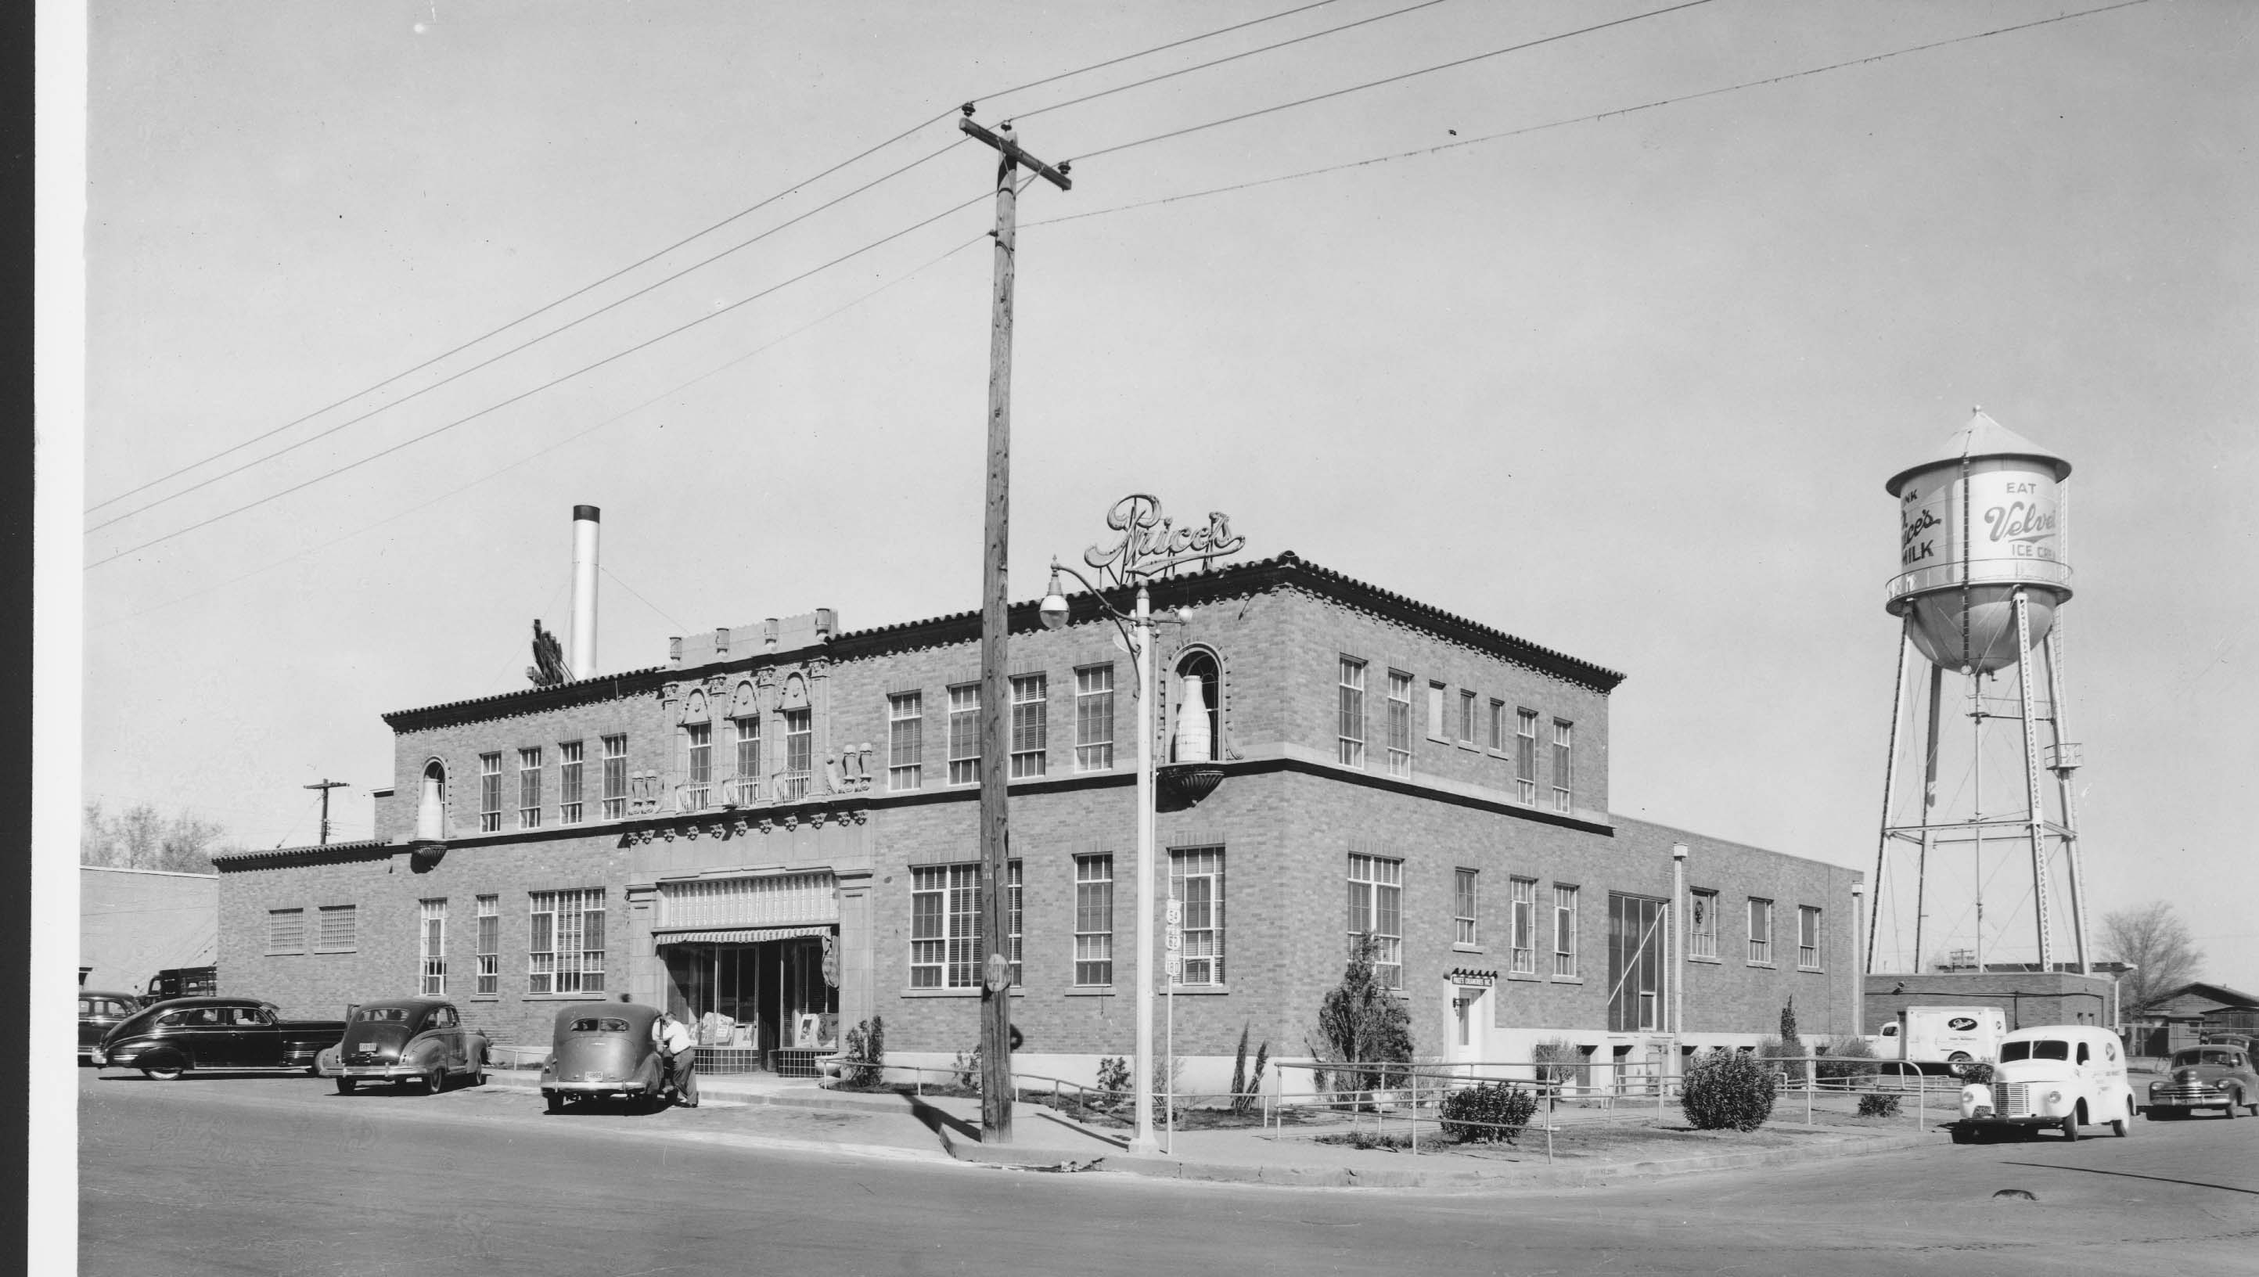
Miskimins’s Recollections
Price’s Dairy (opened in 1906—was located in Five Points by 1918)
Depression — “Ice cream, double dip, cost five cents each.”
“As a business district, Five Points wasn’t all that much, I guess in comparison with today’s standards. It was just a random combination of “points” where a hospital had been built and stores had been accumulated.”
“You did your shopping in this small community.”

Slide 10
Five points 1949

Slide 11
Five points 1990

Slide 12
Five points 1990

Slide 13
Five points 1990

